Slide 1
Cluster and Cloud Computing – Lecture 1 Professor Richard O. Sinnott Director, eResearch University of Melbourne rsinnott@unimelb.edu.au

Slide 2
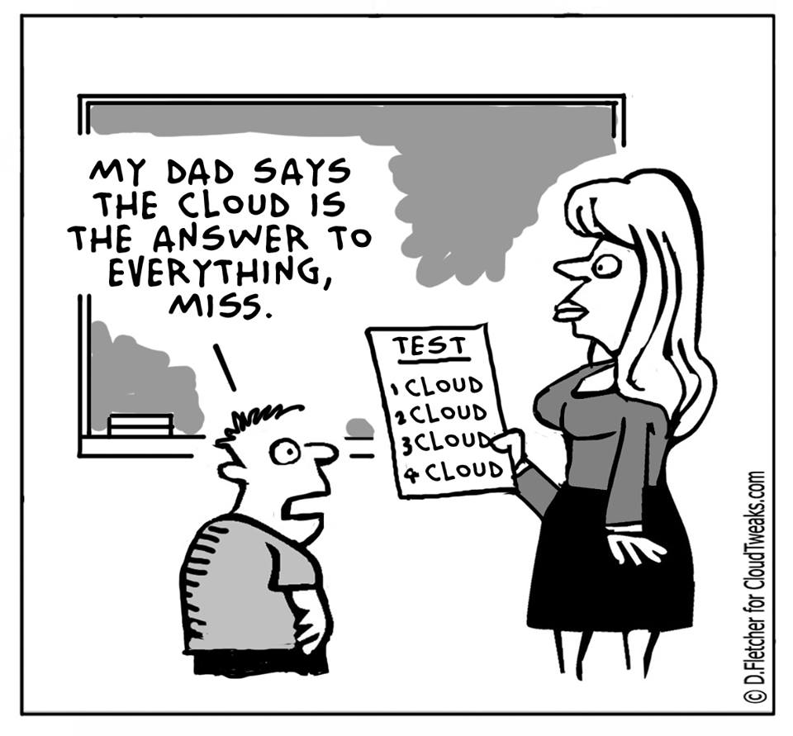
?

Slide 3
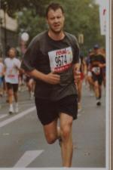
Richard
Director, eResearch University of Melbourne
Chair in Applied Computing Systems, University of Melbourne
BSc Theoretical Physics
CEO Own Company (real time systems/telecoms)
Lecturer
Technical Director National e-Science Centre, University of Glasgow
Technical Director, Bioinformatics Research Centre University of Glasgow
PhD Distributed Systems
Post-doc GMD Fokus Berlin
Multiple PhD/MSc supervised in this area
Distributed Systems Standards creator
MSc Software Engineering

Slide 4
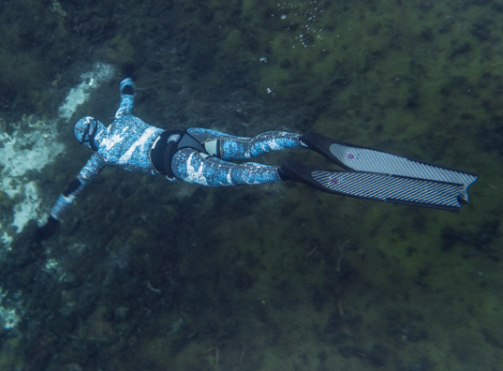
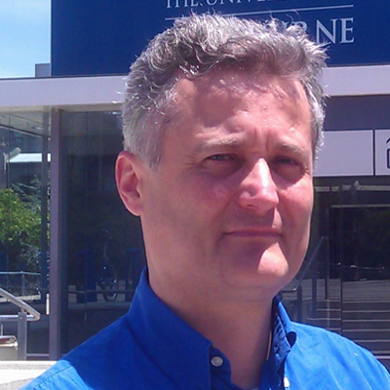
Luca
MSc Statistics
IT Consultant for the World Bank, United Nations, European Union, Asian Development Bank
Committer at the Apache Software Foundation
GIS Software Engineer, ESRI
Data Architect,
AURIN Project
Notes:
The University of Melbourne
MELBOURNE RESEARCH
www.research.unimelb.edu.au
4

Slide 5
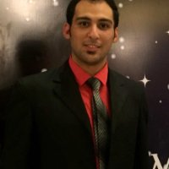
Farzad
University of Melbourne
Doctor of Philosophy (PhD)
Software Engineer
(CAT)
Internet of Things
Big Data
Cloud Computing
Shiraz University
Bachelor of Science
IT
Sharif University of Technology,
Master of Science,
Information Technology
COMP90024 graduate

Slide 6
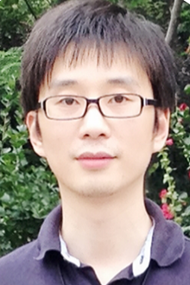
Yao Pan
University of Melbourne
Doctor of Philosophy (PhD)
devOps
(SWARM)
Cloud Computing
Container and Orchestration tool benchmarking
Master of Science IT
UniMelb
COMP90024 graduate

Slide 7

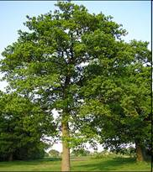

























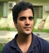












Melbourne eResearch Group (http://eresearch.unimelb.edu.au)
2010
2011
2012
2013
2014
2015
2016
2017
2018
2019
Funding from many funding sources (DARPA, IARPA, DSTG, EU, JDRF, HCT, NHMRC, ARC, Dept Innovation, Dept Environment, VicHealth, Commercial, …)
450+ Masters dissertations
ALL ABOUT APPLIED COMPUTING

Slide 8

Completed
Project Portfolio
Subset of On-Going
National e-Science Centre (I, II, III)
Dynamic Virtual Organisations for e-Science Education
Biomedical Research Informatics Delivered by Grid Enabled Services
GridNet, GridNet-2
Grid Enabled Microarray Expression Profile Search
Glasgow early adoption of Shibboleth
Joint Data Standards Survey
ESP-Grid
HPC Compute cluster award // Sun industrial sponsorship
OGC Collision
OMII-Security Portlets // OMII-RAVE
Integrating VOMS and PERMIS for Superior Grid Authorization
NCeSS
CESSDA PPP
Pharming of Therapeutic RNA
Grid Enabled Occupational Data Environment
Towards an e-Infrastructure for e-Science Digital Repositories
Grid enabled Biochemical Pathway Simulator
Virtual Organisations for Trials and Epidemiological Studies
A European e-Infrastructure for e-Science Repositories
Modelling, Inference and Analysis for Biological Systems up to the Cellular Level
Drug Discovery Portal
Parliamentary Discourse
Scots Words and Placenames
Qvolution stress management survey system
Advanced Grid Authorisation through Semantic Technologies ShinTau
AlstromUK VRE
Grid-enabled Virtual Safe Settings
Clinical Streaming Transcription Software
Enhancing Repositories for Language and Literature Researchers (ENROLLER)
Proxy Credential Auditing Infrastructure for the NGS
Scottish Bioinformatics Research Network (SBRN)
Generation Scotland Scottish Family Health Study
Breast Cancer Tissue Biobank
Data Management through e-Social Science (DAMES)
Meeting the Design Challenges of nanoCMOS Electronics (nanoCMOS)
EU FW7 AvertIT
EU FW7 EuroDSD
NeSC Research Platform (NRP)
NeSC Information Network (NIN)
ESF Network for Study of Adrenal Tumors
Scottish Health Informatics Platform for Research (SHIP)
National E-Infrastructure for Social Simulation (NeISS)
EU R4SME Diagnosis of Parkinsons Disease (DiPAR)
Automating River Pollution Detection (CAPIM)
Endocrine genomics Virtual Laboratory (endoVL)
DSDNetwork Australasia
EU European Platform for Study of Wolfram, Alstrom, Bardet Biedl (EuroWABB)
Multicenter prospective study of biochemical profiles of monoamine-producing tumors (PMT Study)
European Society of Hypertension Study on Pheo/PGL
International DSD
EU FW7 European Network for Study of Adrenal Tumors Cancer Research Platform (ENSAT-CANCER)
VicHealth Health Indicators and Spatial Objective Data
National Spinal Injury Research Platform
Australian Urban Research Infrastructure Network (AURIN)
Epilepsy e-Learning portal
Type-1 Diabetes study of environmental factors on onset of T1D
Australian Diabetes Data Network (ADDN)
International Niemann-Pick A, B and C Registry
Carlton Connect Data Journalism in the Big Data Era
FAMIAN - Combined 18F-fluorodeoxyglucose positron emission tomography and 123I-Iodometomidate Imaging for Adrenal Neoplasia
Melbourne Genomics Health Alliance (variant DB)
NeCTAR Cloud Encryption/Decryption and Secure Deletion
CRE for Protection of Pancreatic Beta Cells
Airbox (Atmospheric Physics and Climate Research)
NESP Clean Air and Urban Environments
Application of omics-based strategies for improved diagnosis and treatment of endocrine hypertension
Youth alcohol consumption database and mobile app
LIDAR Data Analytics Research Environment
Type-1 Diabetes Clinical Research Network
American Asian Australian Adrenal Alliance
International League Against Epilepsy
Platform for Research Software Solutions (PRESS)
Mobile applications for the Environmental Determinants of Islet Autoimmunity
Secure Data Solutions for the Biomedical Communities of the Cloud
Metabolomics Sample Management and Processing Platform
Linked Data PolicyHub Stage II: Urban & Regional Planning & Communications
Australian Genomics Health Alliance
Melbourne Genomics Health Alliance
Australian Diabetes Data Network – Phase II (ADDN2)
Helicopter advanced training system, Australian Department of Defence
Hort-eye Cloud analytics
Public Records Office Victoria Data Management Solutions
Complex System Modelling Platform and GPU utilisation
Public Records Office Victoria Data Management Solutions Follow-Up Grant
VicHealth 2016 Indicators API
Helicopter advanced training system Phase II, Australian Department of Defence
Twitter data analytics for business
Mobile Applications for Patients with Neuroendocrine Tumours
Systems Genomics Support Platform
SWARM: Smartly-aggregated Wiki-style ARgument Marshalling (SWARM)
ORCA Cognitive Assessment Platform
88days Backpacker app
VicSpin Victoria-wide Flu Survelllance System
ElectraNetLIDAR/VectorNZ Lidar
Growing Landscape Carbon
Replicats
Examples used throughout

Slide 9
Course Contents
Lectures 1 & 2 - 6th March
Information Session & How we got here (Distributed Systems, Grid…)
Richard Sinnott
Lectures 3 & 4 – 13th March
Domain Drivers – tour of some big data projects
Richard Sinnott
Lectures 5 & 6 – 20th March
Parallel Systems, Distributed Computing and HPC/HTC
Richard Sinnott
(First assignment handed out!!!)
Lectures 7 & 8 – 27th March
HPC @ UniMelb and Practicalities of HPC/HTC
Richard Sinnott, Lev Lafayette & Farzad Khodadadi
Linux and HPC practicalities and welcome to Spartan!!!
Using mpi4py workshop
Warning SPARTAN & volume students!!!
Team of two for assignment!!!

Slide 10
Course Contents
Lectures 9 & 10 – 3rd April
Cloud Computing – Programming Clouds: Getting to grips with the NeCTAR/UniMelb Cloud!
Richard Sinnott & Farzad Khodadadi & Yao Pan
Introduction to Cloud Computing
Getting to grips with OpenStack/NeCTAR
Scripting for the Cloud (Introduction to Ansible demonstration) workshop
(Optional!!!) Code versioning systems and GitHub (Git) workshop
Second Programming Assignment handed out
Lectures 11 & 12 – 10th April
ReST, Twitter (Needed for Assignment II) & Docker
Richard Sinnott, Farzad Khodadadi & Yao Pan
Web services and Representational State Transfer (ReST)
Hands-on examples of coding/demonstrating ReST and Twitter
Introduction to Microhosting Environments and demonstration of (Docker/Docker SWARM)
Lectures 13 & 14 – 17th April
Big Data and Related Technologies
Luca Morandini (Data Architect, AURIN)
Big Data V-challenges, CAP Theorem and noSQL technologies
CouchDB workshop via Docker

Slide 11
Course Contents… ctd
Lectures 15 & 16 – 24th April
Big Data Analytics
Luca Morandini
Big Data Technologies – Hadoop, HDFS, Spark, …
Hadoop cluster on Cloud and practical application workshop
Discussion of 2nd Programming Assignment
Lectures 17 & 18 – 1st May
Cloud Underpinnings and Other Things
Richard Sinnott & Farzad Khodadadi & Luca Morandini
Virtualisation background
Compare and Contrast AWS with NeCTAR
Serverless architectures
Demonstration of open Function as a Service (openFaaS)
Discussion of 2nd Programming Assignment
Lecture 19 & 20 – 8th May
You (+ pizzas!)
12 teams randomly chosen to present their assignment II
15minutes each

Slide 12
Course Contents… ctd
Lecture 21 & 22 – 15th May
Security and Clouds & demonstration of assignments
Richard Sinnott & You
8 more teams randomly chosen to present their assignment II
15minutes each
Lecture 23 & 24 – 22nd May
Subject Review and Working Through Past Papers
Feedback and SES
Richard Sinnott

Slide 13
At the end of the course….
You will…
Understand more about the history of cluster and Cloud computing and the current state of the art
Know more of the domain drivers that are shaping this area – especially the current flavour of the month “big data”
Understand more on parallel systems, multi-core software development
Be able to use HPC/HTC systems
Be able to use Cloud resources
Be able to develop applications running on the Cloud
Learning about next generation data management systems
Be savvy with web based systems development
Work on a non-trivial software system development as part of a team (=how it nearly always works in the real world!)
Learn more the pulse of cities!
Have software experiences that are in great demand
Many of my ex-students have jobs in this space (reference machine!!!)
Have visited a data centre

Slide 14
Lecture Slides
On the web before lecture
They may be updated slightly before the lecture to reflect recent developments
Or cover materials that folk want more details on from previous lectures
Other sources of materials
Key papers
Interesting articles
Snippets from the web
Crib sheets for Cloud Computing
Crib sheets for HPC

Slide 15
Course Assessment
Assignments
During semester worth 50%
Expected to take about 40+ hours
Written examination
A written examination (two hours) at the end of the semester worth 50%
All components must be completed satisfactorily to pass the subject
At least 50% in all assignments + exam

Slide 16
Assessments
(Mini Team) Assignment 1 – 10 marks
HPC exercise (search/analyse large text file)
(Big Team) Assignment (40 marks)
Social media analytics on the Cloud
Team-based approach
Self organise vs be organised
Importance of being a team player!
Peer review…
Exam – 50 marks
Note
Importance of original work
Collusion “seriously frowned” upon
Use of Turnitin & MOSS

Slide 17
Computational Resources
Departmental Computing Resources:
You all have access to PCs in the lab with Linux and Eclipse installed
Any local issues then talk to CIS technical staff
HPC systems
SPARTAN cluster – general purpose cluster for UniMelb
Provisioned last year
Reasonable grunt, but… UniMelb!
Cloud resources
NeCTAR research cloud – www.nectar.org.au
30,000 servers across Australia (availability zones)
Small (4Gb), medium, large, xlarge, xxlarge (64Gb)
MUCH more on NeCTAR later
UniMelb resources specifically set aside for course!

Slide 18
Workshops…?
Where/when are the workshops/lab sessions…?
In this course workshops are really demonstrations
Materials made available before the lecture/workshop for you to follow (or at your own time at a later date)
We will teach the theory and then do live demonstrations of solutions
Starts from week 4 onwards

Slide 19
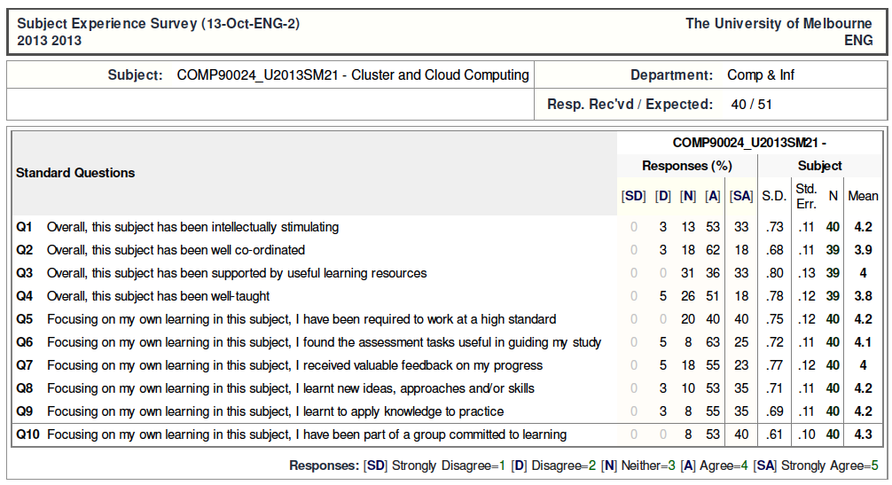
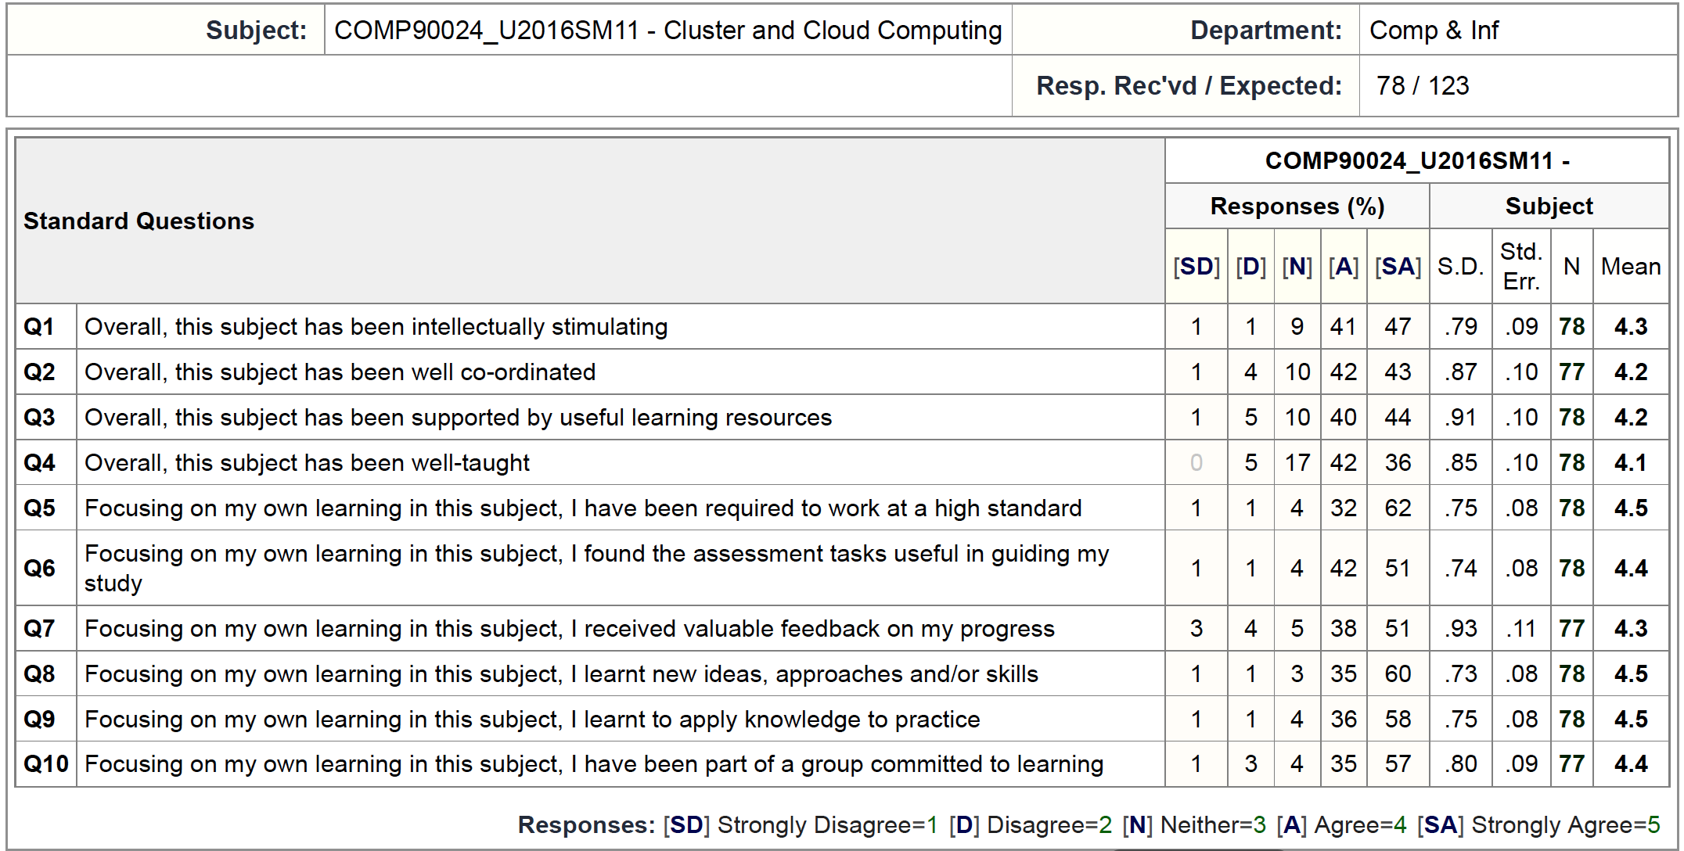
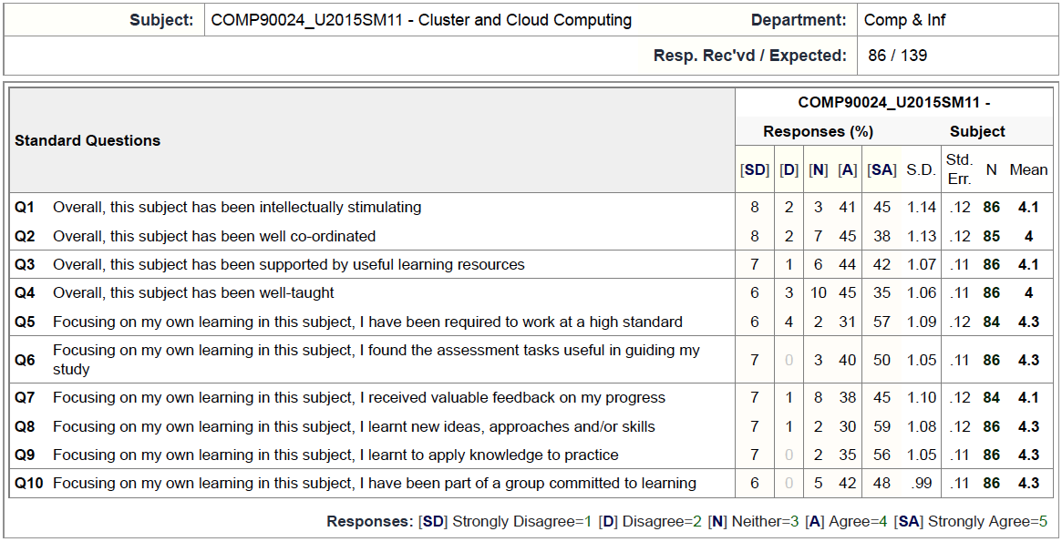
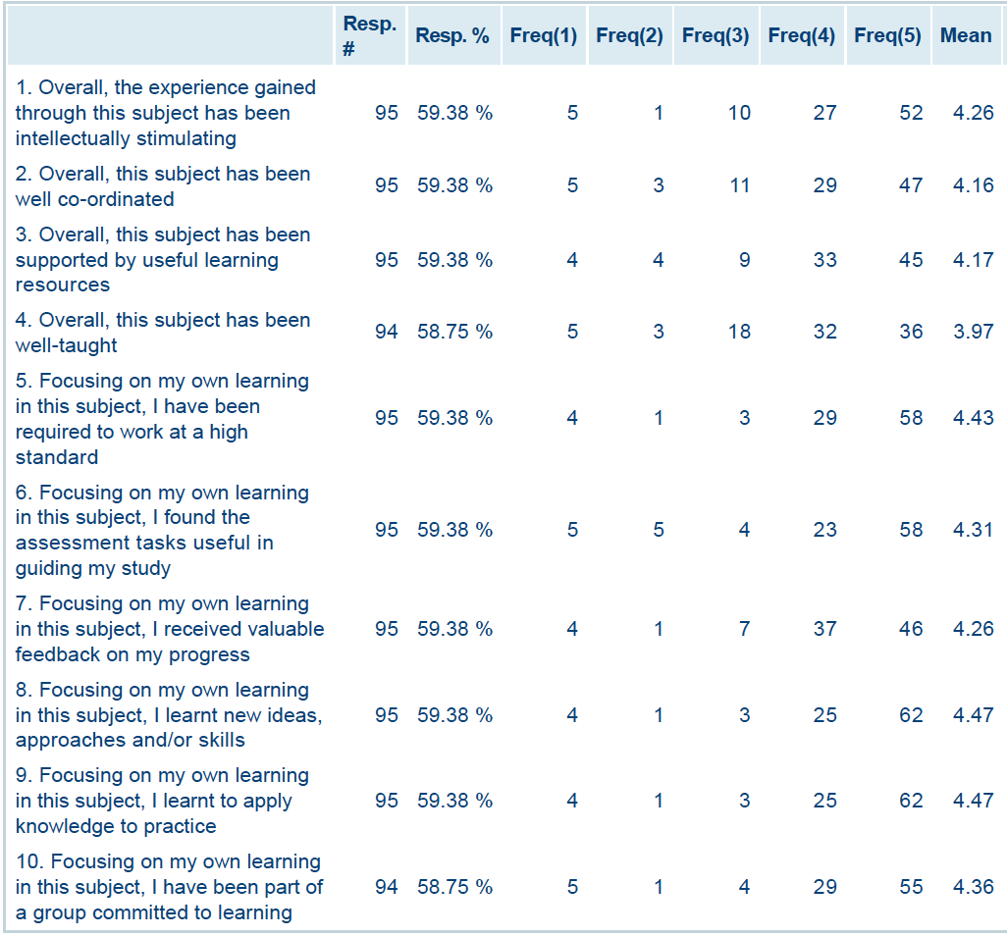
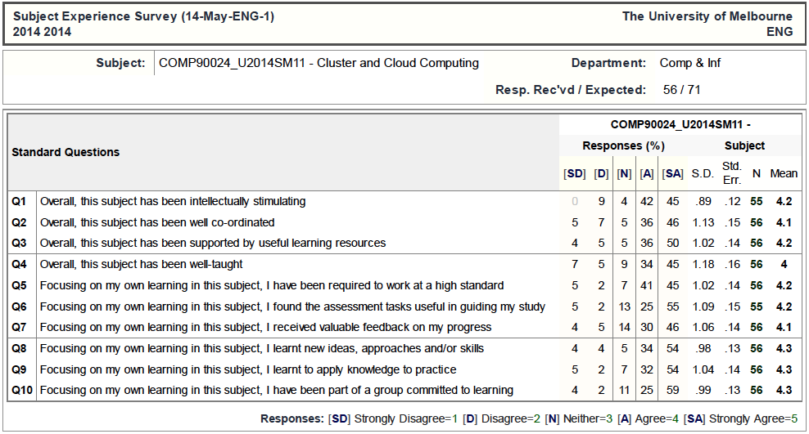
Student Evaluation Survey
(Told I should provide this info!!!)

Slide 20
Questions?

Slide 21
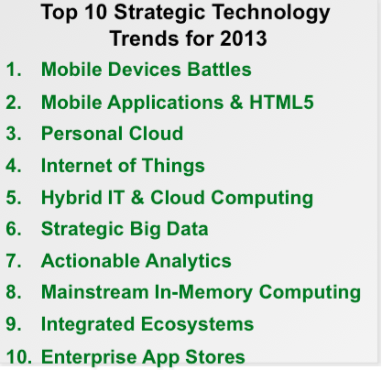

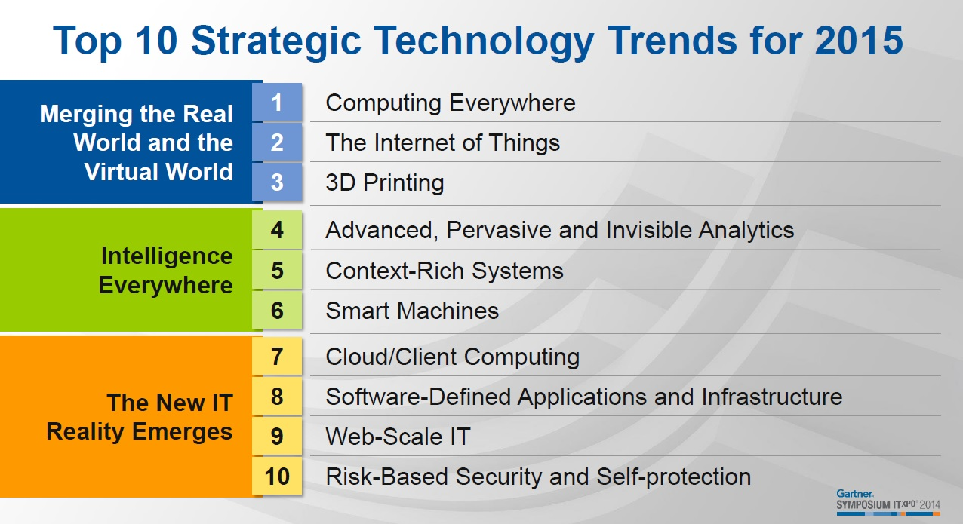
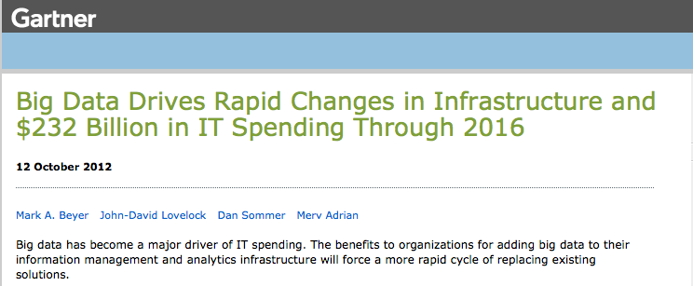
The Buzz

Slide 22
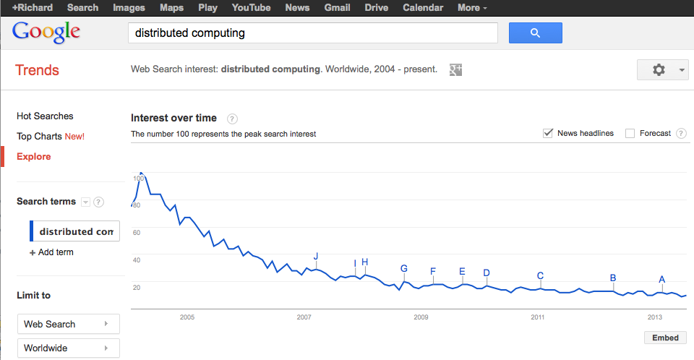
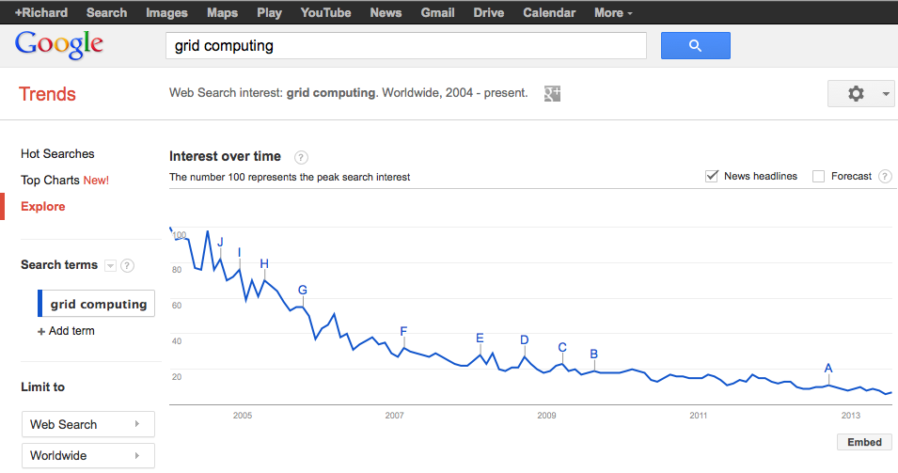
The not so long ago buzz…

Slide 23
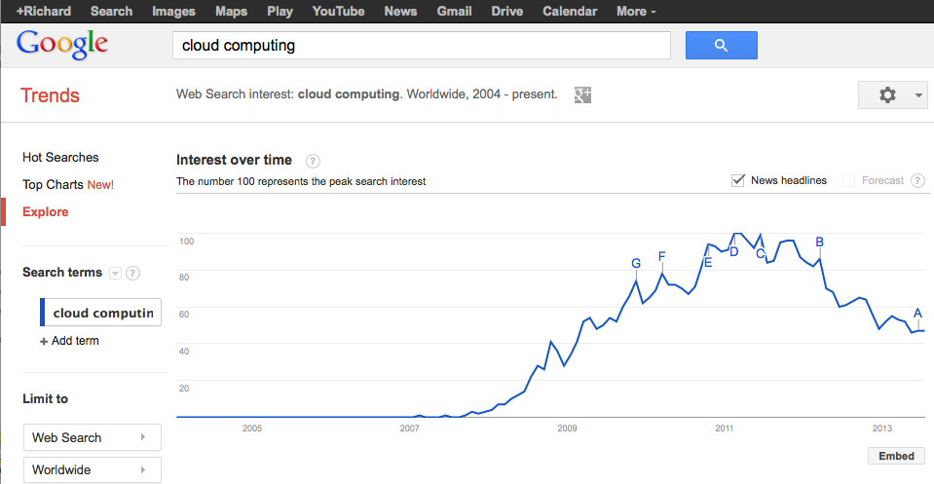
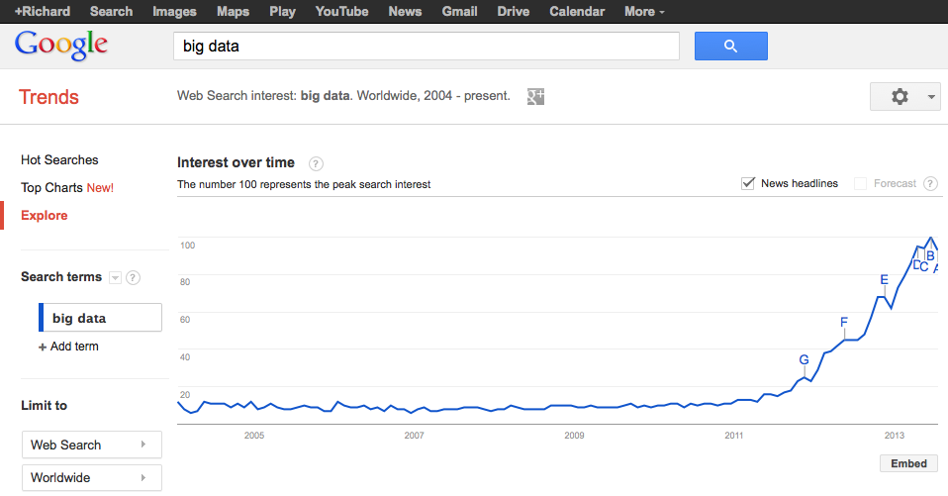
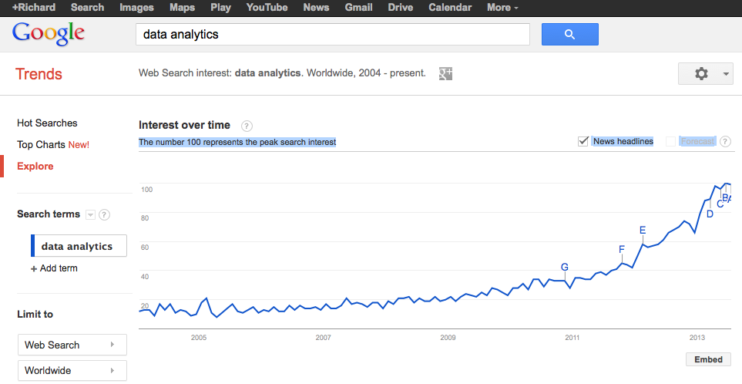
The latest buzz…

Slide 24
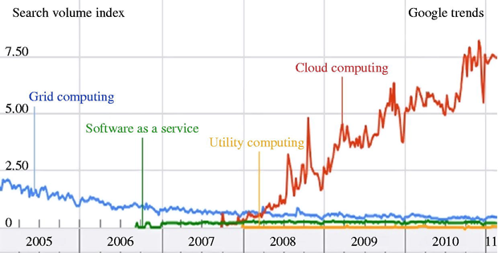
The cycles we go through…

Slide 25
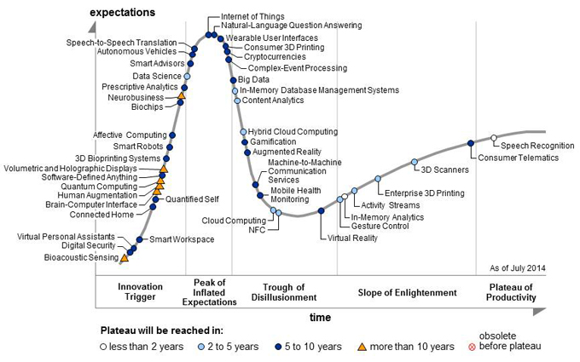
The Hype Cycle… (Gartner 2015)

Slide 26
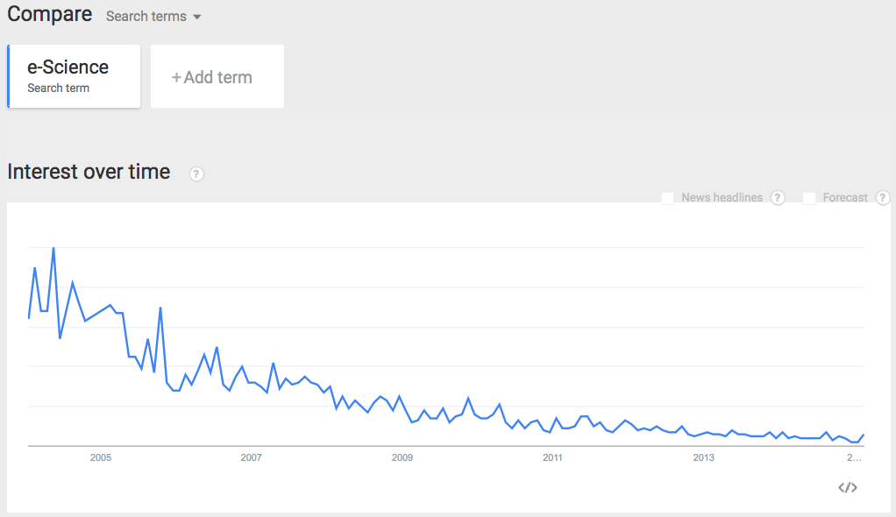
Not just IT trends…

Slide 27
Lessons…
Don’t be fooled by the hype
Marketing and business drivers
The basic principles of software engineering persist
NeSC -> MeG experiences
Data processing,
Distributed systems,
Security …
Learning from experiences is key
But obviously working on/with the bleeding edge can do no harm (for grants or on CVs)

Slide 28
Computing and Communication Technologies (r)evolution: 1960-…!
Centralised?
Cloud Computing
IaaS, PaaS, SaaS
*
HTC
*
P2P
*
Mainframes
*
Minicomputers
*
PCs
*
Workstations
*
PDAs
COMPUTING
*
Grids
*
Crays
*
PC Clusters
*
XEROX PARC
*
MPPs
*
WS Clusters
Twitter
* e-Science
Facebook
* IETF
* W3C
* e-Research
* TCP/IP
* e-Business
Communication
* Email
* Ethernet
* HTML
* Mosaic
* Web Services
* Sputnik
* Internet Era
* WWW Era
* XML
* SocialNet
* ARPANET
1960
1970
1975
1980
1985
1990
1995
2000
2010
Centralised
Control
Decentralised

Slide 29
Cloud Computing….
…is a colloquial expression used to describe a variety of different types of computing concepts that involve a large number of computers that are connected through a real-time communication network (typically the Internet). Cloud computing is a jargon term without a commonly accepted non-ambiguous scientific or technical definition. In science, cloud computing is a synonym for distributed computing over a network and means the ability to run a program on many connected computers at the same time. The popularity of the term can be attributed to its use in marketing to sell hosted services in the sense of application service provisioning that run client server software on a remote location.
Wikipedia 2013

Slide 30
Cloud Computing….
…Proponents claim that cloud computing allows companies to avoid upfront infrastructure costs, and focus on projects that differentiate their businesses instead of on infrastructure. Proponents also claim that cloud computing allows enterprises to get their applications up and running faster, with improved manageability and less maintenance, and enables IT to more rapidly adjust resources to meet fluctuating and unpredictable business demand. Cloud providers typically use a "pay as you go" model. This can lead to unexpectedly high charges if administrators do not adapt to the cloud pricing model.
Wikipedia 2016

Slide 31
Cloud Characteristics
Five essential characteristics:
On-demand self-service. A consumer can provision computing capabilities as needed without requiring human interaction with each service provider.
Networked access. Capabilities are available over the network and accessed through standard mechanisms that promote use by heterogeneous client platforms.
Resource pooling. The provider's computing resources are pooled to serve multiple consumers using a multi-tenant model potentially with different physical and virtual resources that can be dynamically assigned and reassigned according to consumer demand.
Rapid elasticity. Capabilities can be elastically provisioned and released, in some cases automatically, to scale rapidly upon demand.
Measured service. Cloud systems automatically control and optimize resource use by leveraging a metering capability at some level of abstraction appropriate to the type of service.
National Institute of Standards and Technology

Slide 32
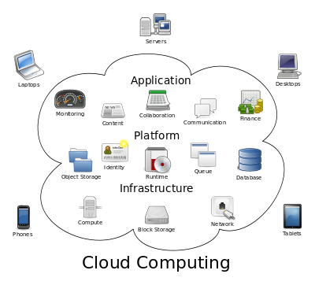
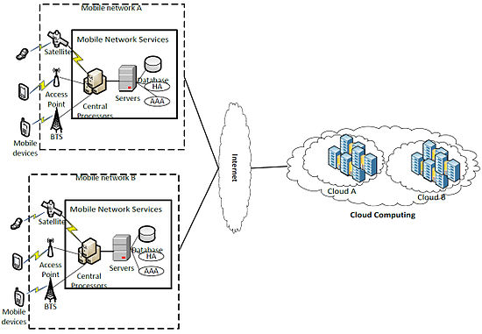
Cloud Computing….
Flavours
Compute clouds
Amazon Elastic Compute Cloud
Azure
…
Data clouds
Amazon Simple Storage Service
Google docs
iCloud
Dropbox
…
Application clouds
App store
Virtual image factories
Community-specific
Private, public, hybrid, mobile, health, … clouds
…

Slide 33
Break…?

Slide 34
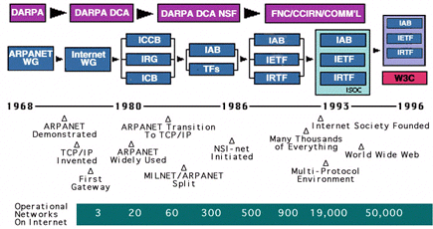
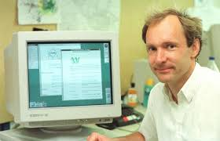
In the beginning….
http://www.internetsociety.org/internet/what-internet/history-internet/brief-history-internet

Slide 35
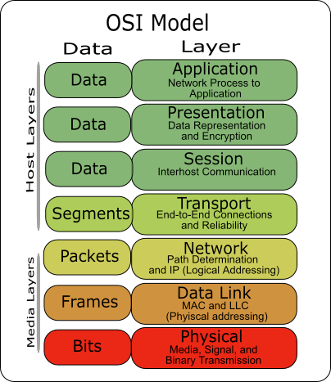
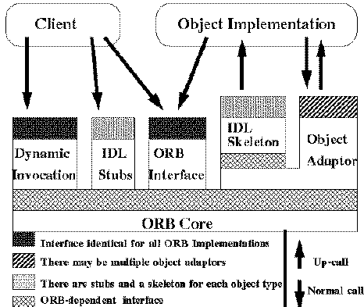
Distributed Systems - A Very Brief History
Once upon a time we had standards
With very detailed conformance, consistency and compliance demands
Services, protocols, inter-operability, …
Then we had more standards
Open distributed processing
With slightly less rigorous compliance demands
OMG Common Object Request Broker Architecture (CORBA)
Distributed Computing Environment
Multiple technologies
Client server, remote procedure call, …

Slide 36
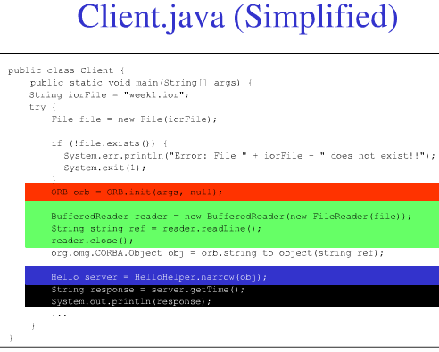
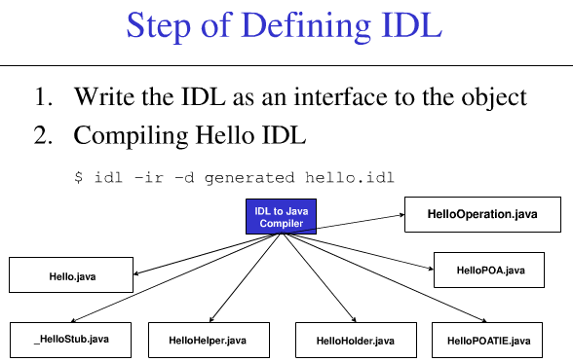
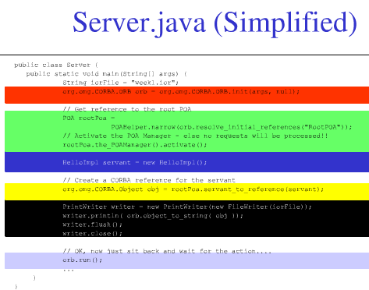
Key distributed systems focus mid-90s
Transparency and heterogeneity of computer-computer interactions
finding/discovering resources (trader!),
binding to resources in real time,
run time type checking,
invoking resources
dealing with heterogeneity of systems
applications and operating systems
focused on computer-computer interaction

Slide 37
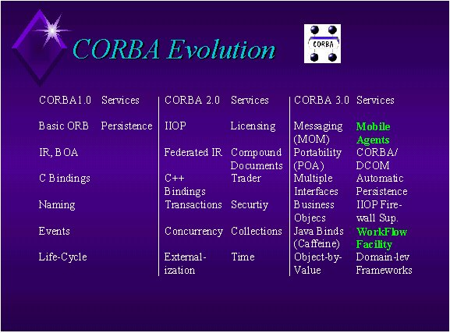

Challenges of earlier distributed (networked) system implementations
Complexity of implementations
Middleware bloat and lock-in
Vision and challenges of reality
Vendor specific solutions
AnsaWare
IBM Distributed SOM / Component Broker
Microsoft Network OLE
IONA Orbix
Visigenic Visibroker
BEA ObjectBroker
HP ORBPlus and Distributed SmallTalk
Expersoft PowerBroker
Other ORB's
Less mature standards
Scale of the problem area
Telecoms, banking, …
The growth (boom!) of the web

Slide 38
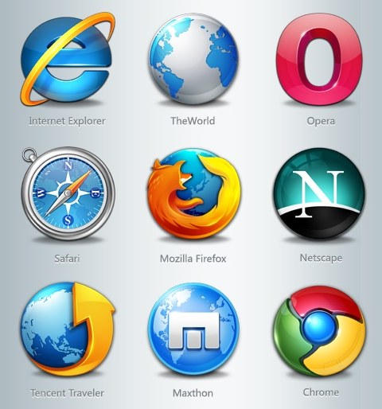
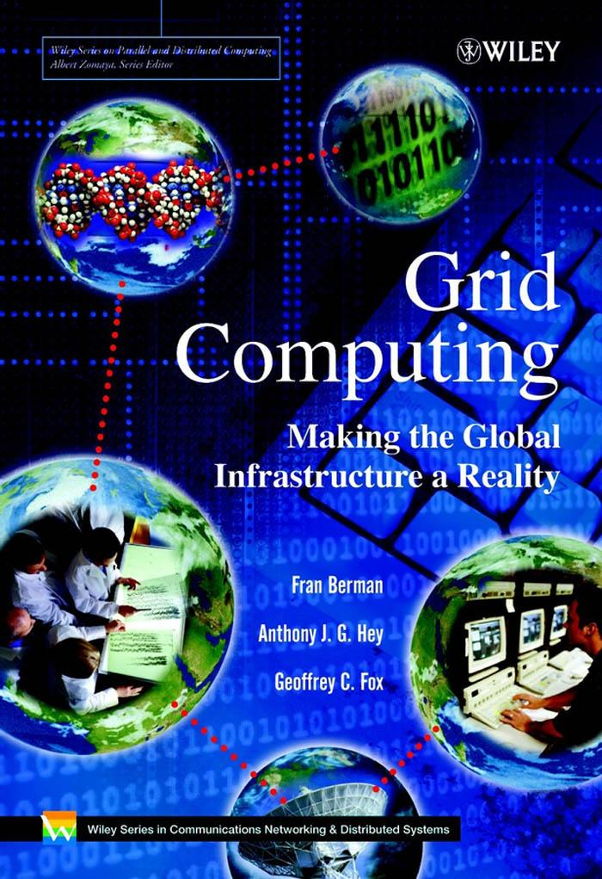
Distributed Systems History…ctd
Enter the web era
My first ftp 1993 put/get files to/from Australia
Then the web pretty much exploded
Peer-peer processing
File sharing …
Scaling of…
machines,
people,
domains of application
Grid computing
From computer-computer focus
To organisation-organisation focus

Slide 39
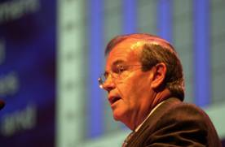
e-Science and the Grid
Circa 2001
Research
‘e
Research
-
Science is about global collaboration in key
areas of science, and the next generation of
infrastructure that will enable it.’
‘e
Research
-
Science will change the dynamic of the
way science is undertaken.’
John Taylor
Director General of Research Councils
Office of Science and Technology
Grid is infrastructure used for e-Science
Power Grid Metaphor: compute and data resources on demand
Major investment by UK Govt (£250m+) to realise this vision
Across ALL Research Councils (+ EU + industry + …)
Cyber-infrastructure, European Grid Initiative, Superscience, …
From presentation by Tony Hey

Slide 40
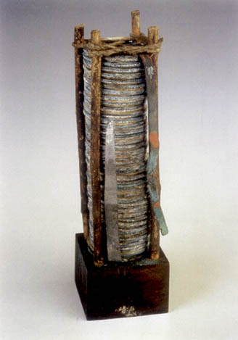
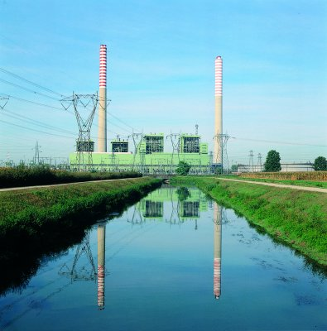
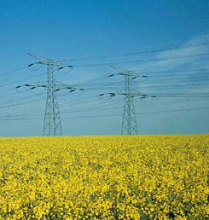
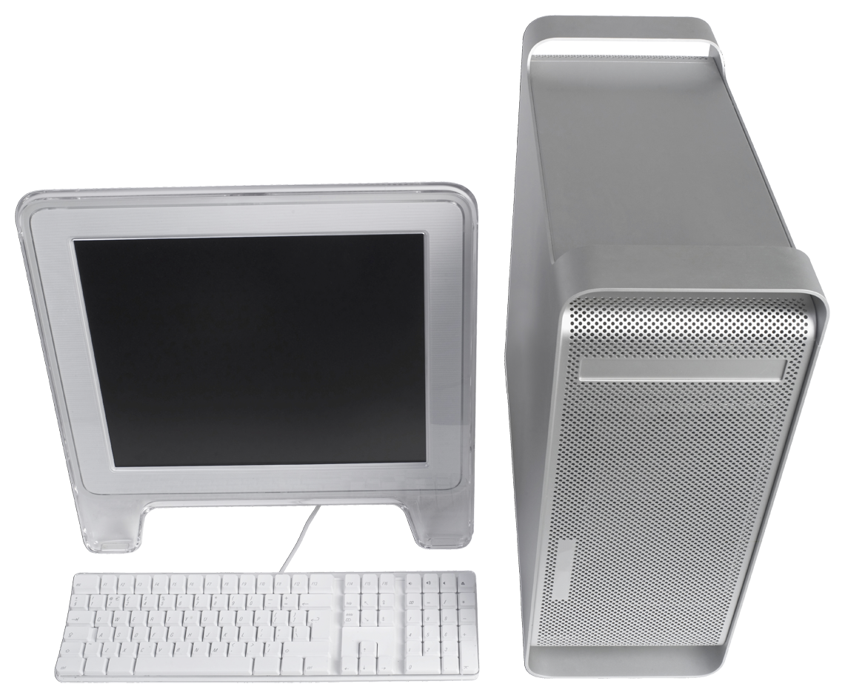
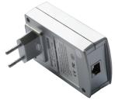
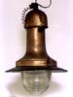
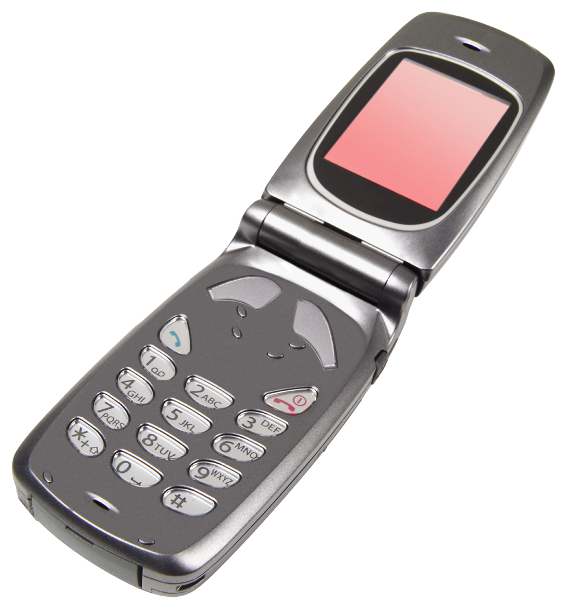
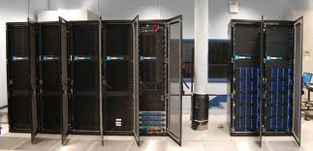
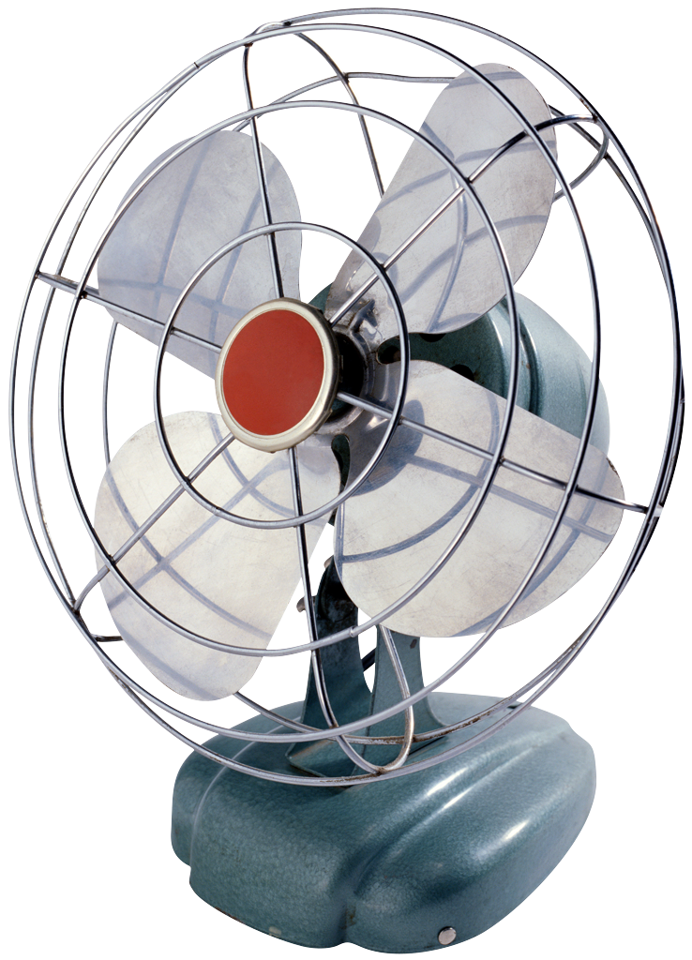
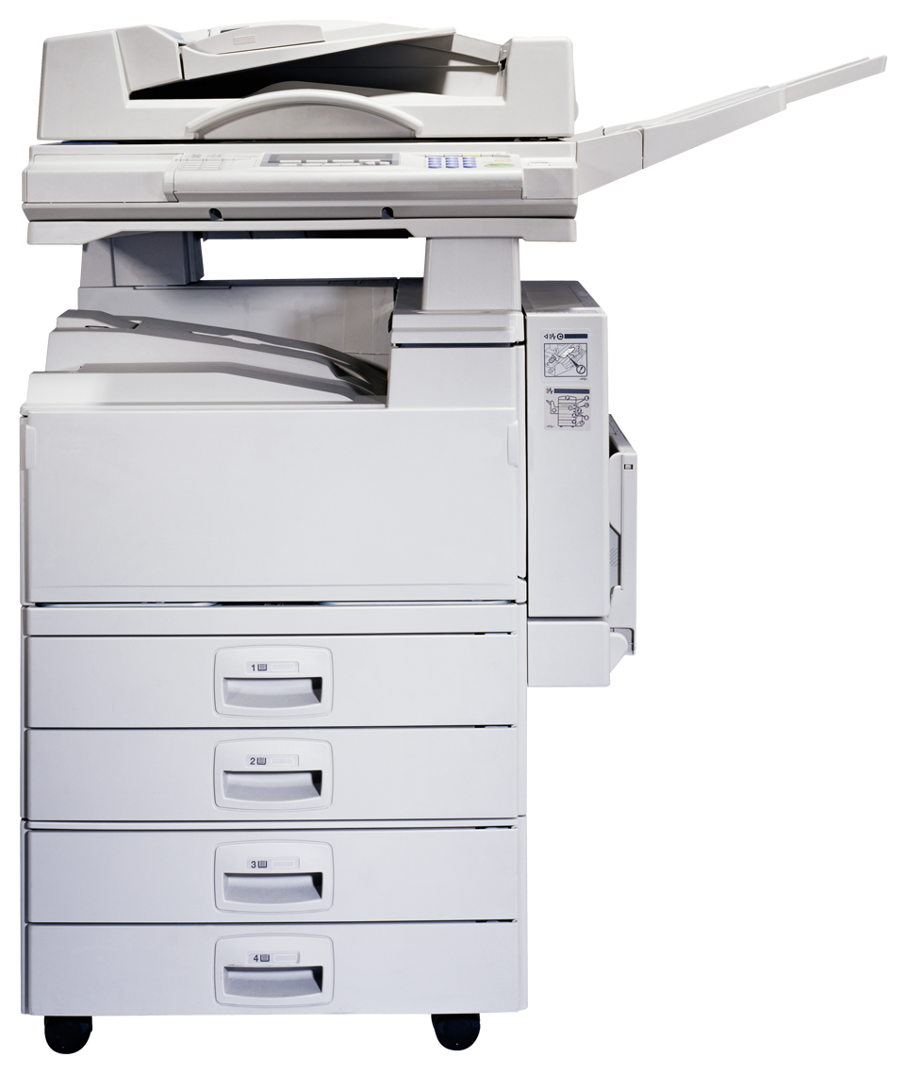

The Grid Metaphor

Slide 41
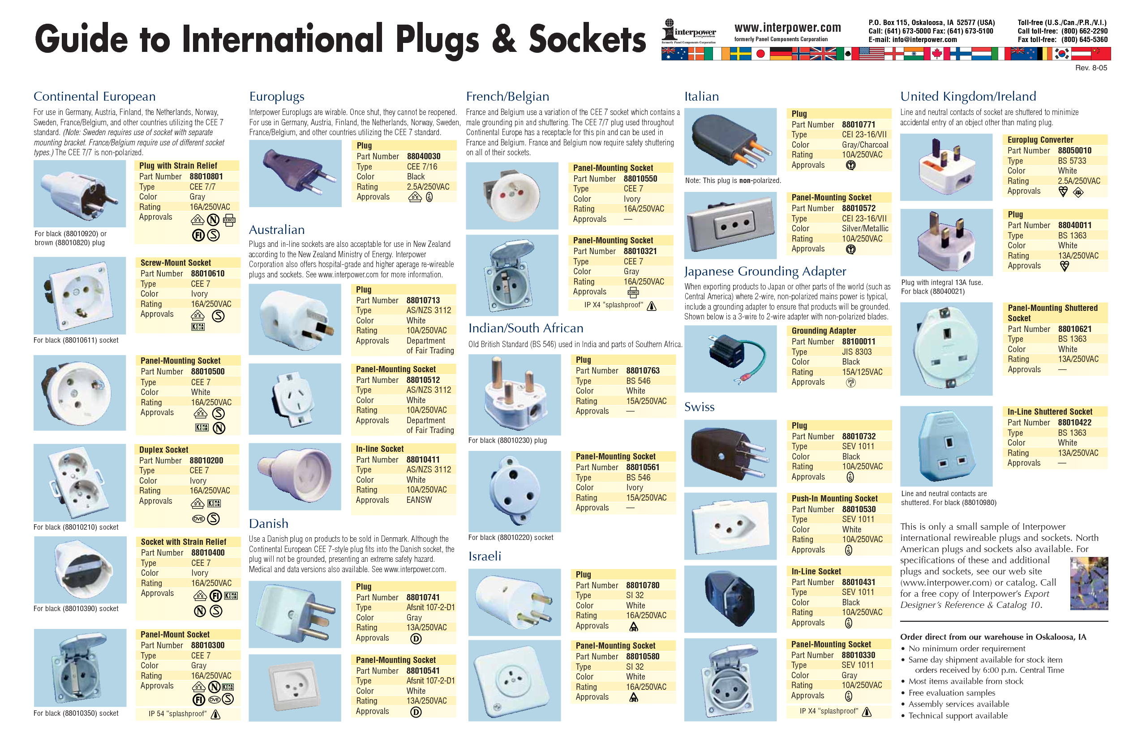
Overcoming heterogeneity…

Slide 42
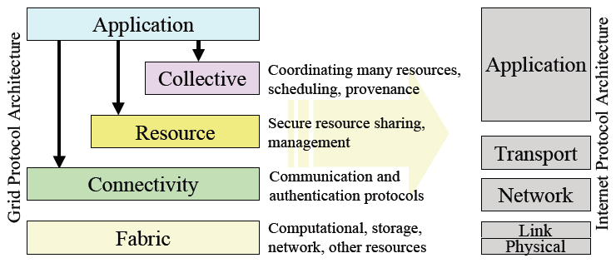
Typical (Compute) Grid Architecture
All sorted…?

Slide 43






Grid Standards
Even increasing numbers and ever decreasing understanding and acceptance/adoption by implementers
Global Grid Forum
Open Grid Forum
OASIS
IETF
W3C
…
+ many more…

Slide 44
Grid Technologies… (~2002+)
Globus Toolkit Project – www.globus.org
GT2 - Complex software system for large, scale distributed software systems development
Physiology of the Grid (Foster et al) www.globus.org/alliance/publications/papers/ogsa.pdf
The Open Grid Services Architecture
The Anatomy of the Grid: Enabling Scalable Virtual Organizations (Foster et al) http://dl.acm.org/citation.cfm?id=1080667
MANY MB of source code
Many software engineers worked in making this
and many more in making it work!!!

Slide 45

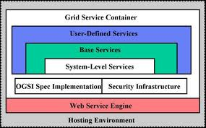
Grid Technologies… (~2004+)
Move to service-based approach
The Open Grid Services Infrastructure (OGSI)
www.globus.org/toolkit/draft-ggf-ogsi-gridservice-33_2003-06-27.pdf
GT3 – core technologies re-factored as “Grid Services”
stateful Web services
extension of Web services interfaces
asynchronous notification of state change
references to instances of services
collections of service instances
service state data augmenting constraints of XML Schema definition

Slide 46

Grid Technologies… (~2009+)
Complete reassessment of OGSI approach to be “purer” web services
Web service resource framework (WSRF)
GT4 implemented this
Many software engineers hardened their skill sets using this (is one nice way of putting it!!!!)
The only way to make software secure, reliable, and fast is to make it small
AS Tanenbaum
Also MANY other standards and efforts …
Business and commercial drivers
Vendors shaping standards to their commercial advantage

Slide 47

Flux of Web Service Standards (simplified!!!)

Slide 48
The nice thing about standards is that you have so many to choose from…
The development of robust Grid security infrastructures is very much dependent upon agreements on technologies and practices. Standardisation plays an extremely important role in this regard. With the move of the Grid community towards web services and service-oriented architectures, web service security standards and their associated implementations are crucial. Unfortunately it is the case that a multitude of specifications and proposals for web service standards have been promised and put forward, or merely promised. There are often cases of web service standards covering similar topics resulting in multiple competing specifications such as WS-Notifications and WS-Eventing; WS-ReliableMessaging and WS-Reliability; WS-Orchestration, WS-Co-ordination and WS-Choreography, along with the many varieties of workflow or business process languages that have been put forward to name but a few examples of the issues in the proliferation of web service standards. It is also the case that at the time of writing, many web services standards are only in working draft or draft status, often with no associated implementations or acknowledged conformance or interoperability definitions. Claiming conformance or compliance to a particular web service standard is thus often not possible (or meaningful!).
It is also apparent that although many standards use the common prefix “WS-”, this does not mean that there is an agreed WS-Architecture. This stems from a variety of reasons: vendor and commercial issues; political aspects and also the different bodies involved. For example the Internet Engineering Task Force (IETF) (www.ietf.org); the World Wide Web Consortium (W3C) (www.w3.org); the Organization for the Advancement of Structured Information Standards (OASIS) (www.oasis-open.org); and the Web Services Interoperability Organization (WS-I) (www.ws-i.org) are some of the most prominent bodies. The consequence of this profusion of standards and standards making bodies, and the lack of consensus on the core web service architecture, impacts directly upon development of Grid standards, architectures and associated implementations and middleware.
Me: Grid Security : Practices, Middleware and Outlook

Slide 49



The UK Grid Ecosystem
Circa 2004
e-Science Institute
NeSC
Core NGS Nodes +HECTOR +partners/affiliates
(HECTOR investment £113m)
Core NGS Nodes +HECTOR +partners/affiliates
(HECTOR investment £113m)
Core NGS Nodes +HECTOR +partners/affiliates
(HECTOR investment £113m)
National Centre for e-Social Science
National Centre for e-Social Science
National Centre for e-Social Science
National Data Centres
+ UK Federation
+ International dimension
including EGEE/EGI
+ SuperJanet
+ Training/Education
+…
National Centre for Text Mining
Grid Operations
Support
Centre
NERC e-Science Centre
CeSC (Cambridge)
National Institute
for Environmental e-Science
OMII-UK
OMII-UK
OMII-UK
Digital Curation Centre
Software Sustainability Institute
Digital Curation Centre
Digital Curation Centre
Digital Curation Centre

Slide 50


How hard can a compute Grid be…?
Information Systems
What resources are available
Servers, CPUs, memory, storage, queues,
OS, applications, databases, …
Monitoring and Discovery Systems
What is the status of those resources
Queues empty/very full
Machines running for a week
Hard to tell for some applications…?
Job scheduling/resource brokering
Please run these {jobs}
Fastest, most secure/reliable, cheapest …
Jobs need inter-process communication…?
never get resources vs resource starvation
Physics pilot jobs workaround
Virtual organisation support
I’m a chemist and want to run my simulation

Slide 51

Fragility of it all…
How I broke the UK e-Science Grid…

Slide 52


Other Challenges
Security
Public Key Infrastructures
$> openssl pkcs12 -in cert.p12 -clcerts -nokeys -out usercert.pem!
???? (more in later lectures)
E-Researchers
Researchers
(NOT TO SCALE)

Slide 53









Doom and gloom…!?!?
But…

Slide 54



High Energy Physics?
Why did/does Grid work for them…?
Size, scale and resourcing
GridPP
Enabling Grids for e-Science (EGEE)
European Grid Initiative
Huge numbers of admins making systems tick over
(=not searching for Higgs Boson)
Heterogeneity vs homogeneity
Specific versions of operating system
Scientific Linux v4, v5
Specific versions of middleware
Unilateral updates/deployments
globus-*, gLite-wms-*,
edg-job-*, lcg-job-*, GANGA
Well-defined problem…
?

Slide 55

My philosophy since…
Less focus on complex middleware stacks
FAR too much focus on technology issues
More on customer needs and making a difference
And to inspire you (and make you think what you do with social media!!!)
A snapshot of what you will be doing with Twitter analytics!

Slide 56
Questions?

